Slide 1
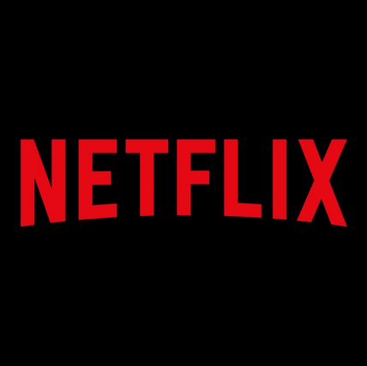
Analyzing Netflix movies and TV shows Using IMDB
Bandi Rohan Reddy
U35879829

Slide 2

Research Questions:
How the release years and average ratings of movies and TV shows on Netflix evolved, and what patterns emerge from the data in terms of content growth and quality over the years?
How does the average rating of titles directed by various filmmakers correlate with their popularity index on Netflix, and does this relationship differ between movies and TV shows?
What trends can be observed in the IMDB ratings of Indian movies over the years?
What were the best movies and TV shows released in each year?
How does viewer engagement, as measured by the number of votes, vary with the duration (number of seasons) of TV shows across different genres on Netflix?
How does the availability of Netflix content across countries compare between movies and TV shows over the years, and what does the trend indicate about Netflix's global distribution strategy?
How do the average ratings for movies and TV shows across different genres on Netflix compare, and which genre receives the highest ratings in each category?
Which actors are most frequently associated with high-rated content on Netflix, indicating a potential "star power" effect?

Slide 3
Data Sourcing:
Kaggle (https://www.kaggle.com/datasets/thedevastator/the-ultimate-netflix-tv-shows-and-movies-dataset)
IMDB Data Source (https://www.kaggle.com/code/adrianmcmahon/imdb-indian-movies-eda/input)
Statista https://www.statista.com/statistics/583249/netflix-series-viewership/
In this project, I used five datasets that covered various aspects of Netflix TV Shows and Movies and IMDB

Slide 4
Further Research Questions:
Content Lifespan and Trends:
What content characteristics from IMDb data are indicative of a longer lifespan on Netflix and potential for becoming evergreen titles?
Cross-Platform Performance Analysis:
How does content performance on Netflix, as reflected by IMDb ratings, compare to its performance on other streaming platforms?
Impact of Critical Acclaim on Subscriber Growth:
Does critical acclaim on IMDb, such as high ratings and awards, translate to subscriber growth and retention for Netflix?
Machine Learning for Content Success Prediction:
Can machine learning models using IMDb data accurately predict the success of future Netflix content in various regions and demographics?

Slide 5

Thank You

